Slide 1
Data Visualization
CS3300 Data Science
RJ Nowling

Slide 2
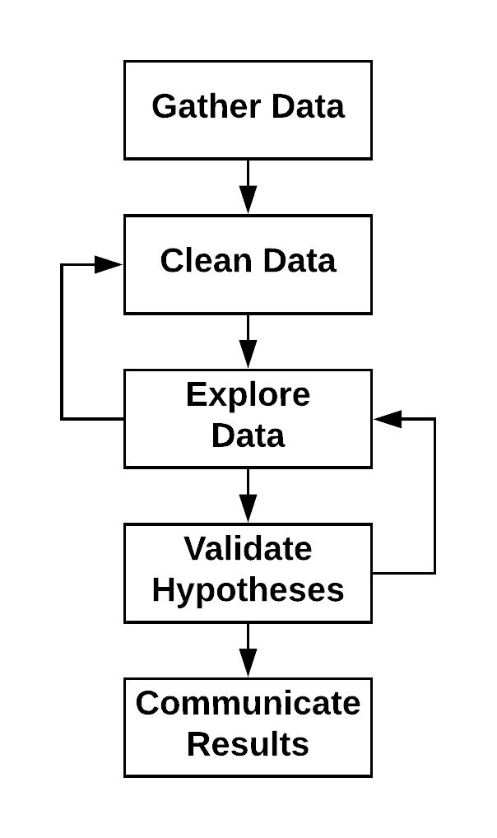
Data Science Process
Application of the scientific method to data
Data Science vs Machine Learning
Data Science: Understand the data and its Relationships better. Uses machine learning to explore data and validate those relationships
Machine Learning: Goal is to build a predictive model. Data Science is used to identify variables for the models and evaluate the models by creating an experimental framework

Slide 3
Exploratory Data Analysis
"[D]ata-driven science starts by assembling a substantial data set, and then hunts for patterns that ideally will play the role of the hypothesis for future analysis." – DSDM
Exploratory data analysis (EDA) is the search for patterns and trends in a given data set
Visualization techniques play an important part
Outcomes:
Suggest interesting hypotheses
Identify data processing mistakes / outliers
Find violations of statistical assumptions

Slide 4
Exploratory Data Analysis: Basic Questions
Where did the data set come from?
How big is the data set?
What types of fields does the data set have? What are their types and meanings?

Slide 5
Plotting

Slide 6
Visualizing Data with Plots
Exploring your data
What is the range of blood glucose values?
How many times does each value appear in a categorical variable?
Generate Hypotheses / Identify Relationships Between Variables
Does blood glucose vary with the time range of the data set?
Does blood glucose vary week to week?

Slide 7
Variable Types
Numerical
Ordered numerical (e.g., time)
Categorical (including boolean)

Slide 8
Libraries
Matplotlib
Seaborn
Pandas
Bokeh

Slide 9
Color Blindness
Red-Green
8% of males
0.5% of females
import seaborn as sns
sns.set_palette(sns.color_palette("colorblind"))

Slide 10
Single-Variable Plots

Slide 11
Single Variable Plots
Distributions of variables
Numerical (ordered or not)
Histogram
Kernel Density Estimation (KDE)
Categorical
Bar charts
Used to explore ranges of values
Look for outliers

Slide 12
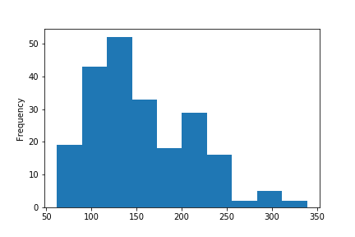
Histogram

Slide 13
Commands
Matplotlib plt.hist(df["column name"], bins=5) plt.hist(df["column name"], bins=np.linspace(-5.0, 5.0, num = 11)
Seaborn sns.distplot(df["column name"], kde=False)
Pandas df["column name"].plot.hist()

Slide 14
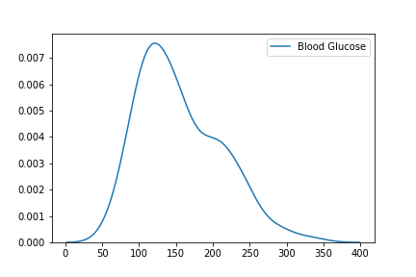
Kernel Density Estimation (KDE)

Slide 15
Commands
Seaborn sns.kdeplot(df["column name"], shade=True)
Pandas df["column name"].plot.kde()

Slide 16
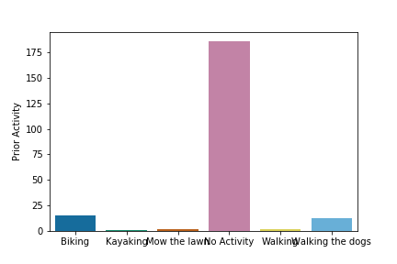
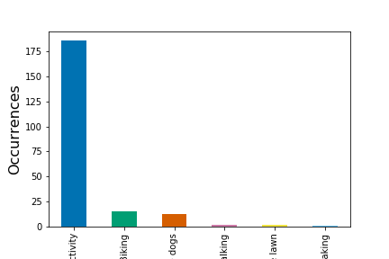
Bar Chart

Slide 17
Commands
Seaborn sns.countplot(x="Prior Activity", data=glucose_readings)
Pandas activity_counts = glucose_readings["Prior Activity"].value_counts() activity_counts.plot.bar(x="Prior Activity") plt.ylabel("Occurrences", fontsize=16)

Slide 18
Two-Variable Plots

Slide 19
Two Variable Plots
Relationship between 2 variables
Numerical – Numerical
Scatter
Numerical – Ordered Numerical
Line plot
Categorical – Numerical
Box plot
Violin plot
Categorical – Categorical
Heatmap
Useful for finding correlations between independent and dependent variables
Identify candidates for use in machine learning models

Slide 20
Predictive Modeling
Goal: Build a model to predict the dependent variable
E.g. predicting blood glucose
We need to find independent variables that correlate with the dependent variable
E.g., time of day, prior activity, week of the year
Plots can be a useful way of exploring which independent variables have a relationship with the dependent variable
Choosing variables to include in a model is part of "feature engineering"

Slide 21
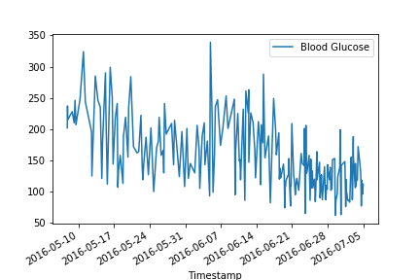
Exploring Glucose Over Time

Slide 22
Commands
Matplotlib plt.plot(df["column1"], df["column2"])

Slide 23
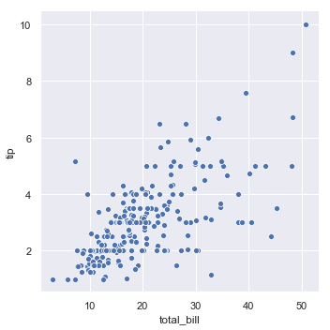
Scatter Plot

Slide 24
Commands
Matplotlib plt.scatter(df["column1"], df["column2"])
Seaborn sns.scatterplot(x="column1", y="column2", data=df)
Pandas df.plot.scatter(x="column1", y="column2")

Slide 25
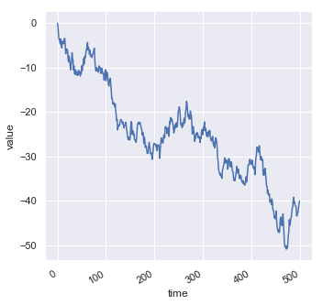
Line Plot

Slide 26
Commands
Matplotlib plt.plot(df["column1"], df["column2"])
Seaborn sns.lineplot(x="column1", y="column2", data=df)
Pandas df.plot.line(x="column1", y="column2")

Slide 27
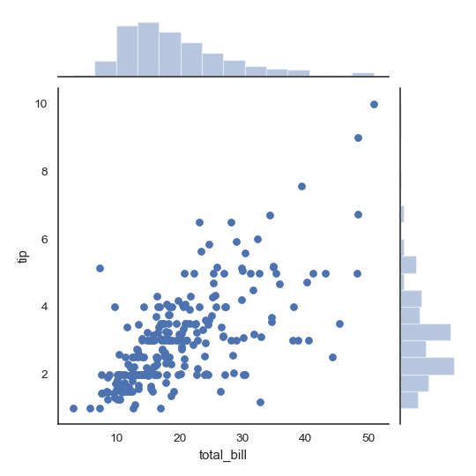
Joint Plot

Slide 28
Commands
Seaborn sns.jointplot(x="column1", y="column2", data=df)

Slide 29
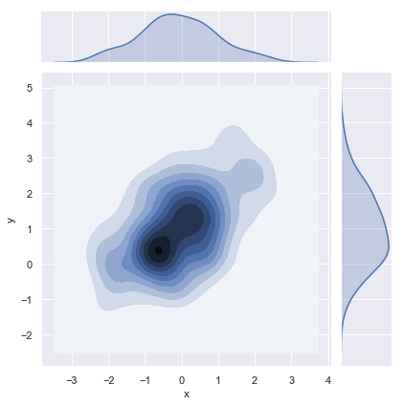
Bivariate KDE

Slide 30
Commands
Seaborn sns.jointplot(x="column1", y="column2", data=df, kind="kde")

Slide 31
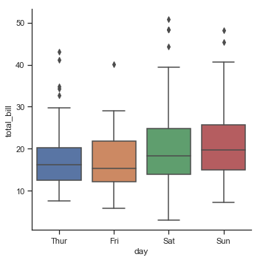
Box Plot

Slide 32
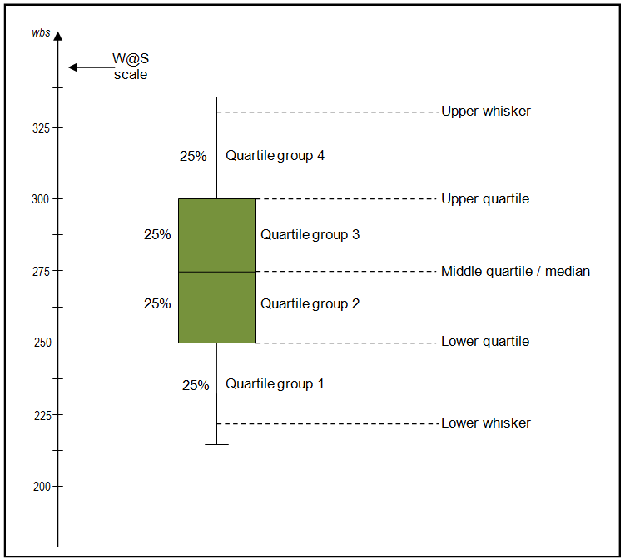
Interpreting a Box Plot

Slide 33
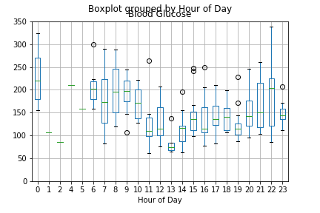
Glucose Varies by Hour of the Day

Slide 34
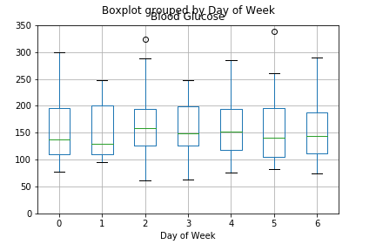
Glucose Varies by Day of Week

Slide 35
Commands
Seaborn sns.boxplot(x="column1", y="column2", data=df)
Pandas df.boxplot(by="column1", column="column2")

Slide 36
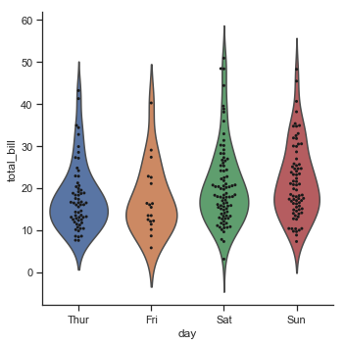
Violin Plot

Slide 37
Commands
Seaborn sns.violinplot(x="column1", y="column2", data=df)

Slide 38
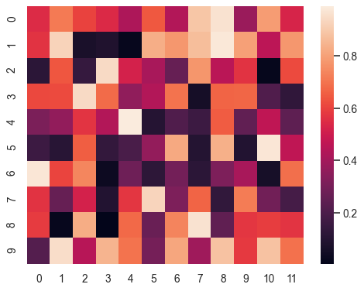
Heatmap

Slide 39
Commands
Seaborn flights = flights.pivot("month", "year", "passengers") sns.heatmap(flights)

Slide 40
Dashboards and Interactive Plots

Slide 41
Dashboards
Many times, data scientists will create "data apps" called dashboards that enable non-technical users (e.g., business users) to perform analysis
Dashboards generally are tied to a specific data set (e.g., some tables in a relational database)
Dashboards update themselves
Dashboards are interactive – users may be able to select variables or groups of records

Slide 42
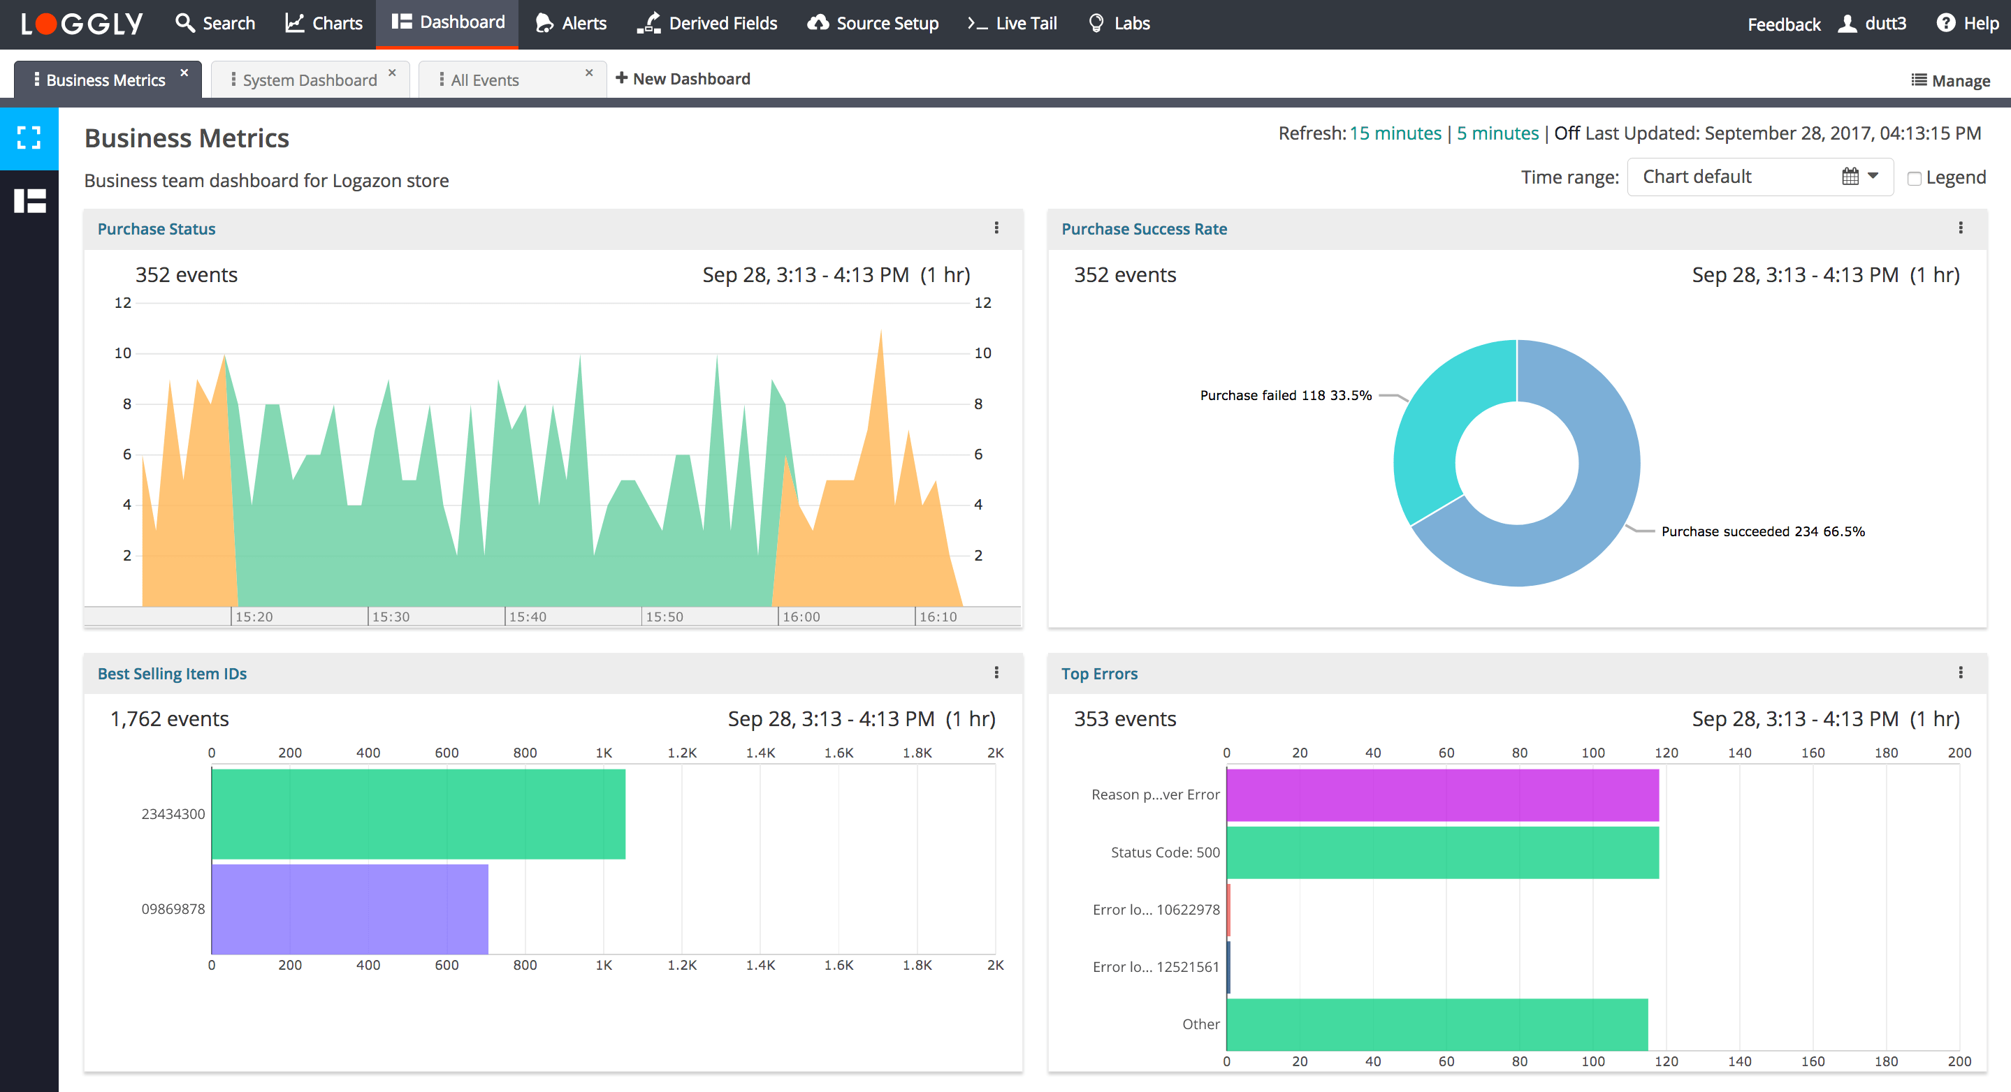
Dashboard Example
https://documentation.solarwinds.com/en/Success_Center/loggly/Content/admin/dashboards.htm

Slide 43
Dashboard Software
Microsoft's Power BI
Tableau
Mode Analytics
Shiny (R programming language)
Bokeh (Python)

Slide 44
Interactive Plots
Custom "data apps" are often developed as web apps
For example, D3.js is a JavaScript library for creating interactive data visualizations
Bokeh can generate single-page web apps with embedded data or a web front-end that connects to a backend

